Slide 1
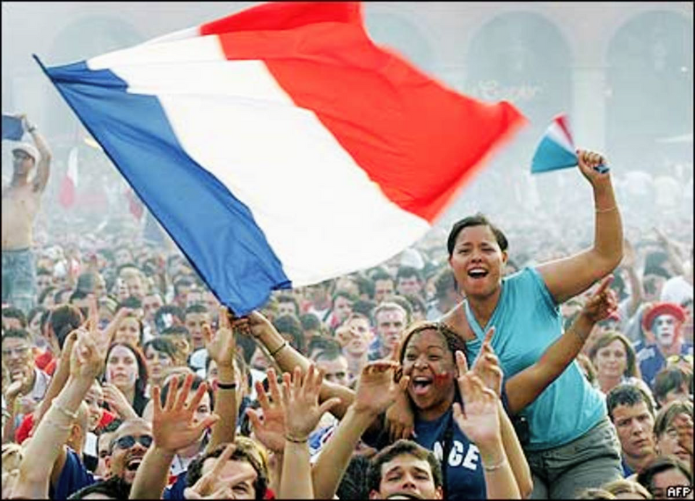

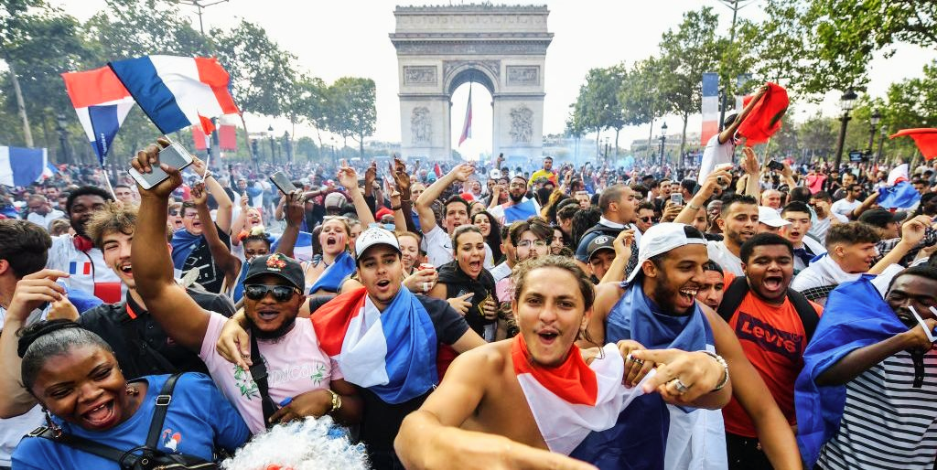
UNDERSTANDING
SOCIETY CULTURE
&
by YASIRU PRABODHA
CL/OTHMFL3/11/90
Notes:
Today, we're diving into the rich tapestry of society and culture, focusing on France as our case study. We'll explore what defines culture, its diverse manifestations, and how subcultures emerge within broader societal contexts.

Slide 2
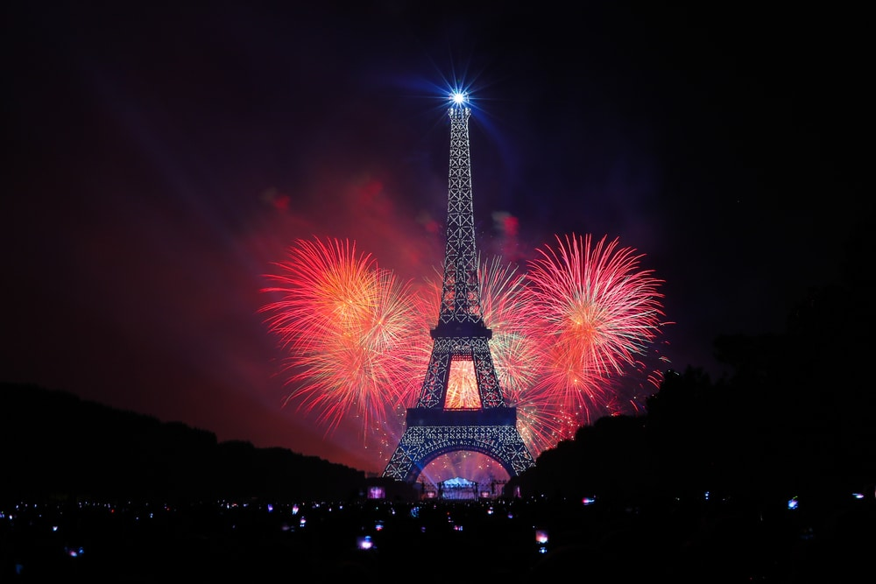
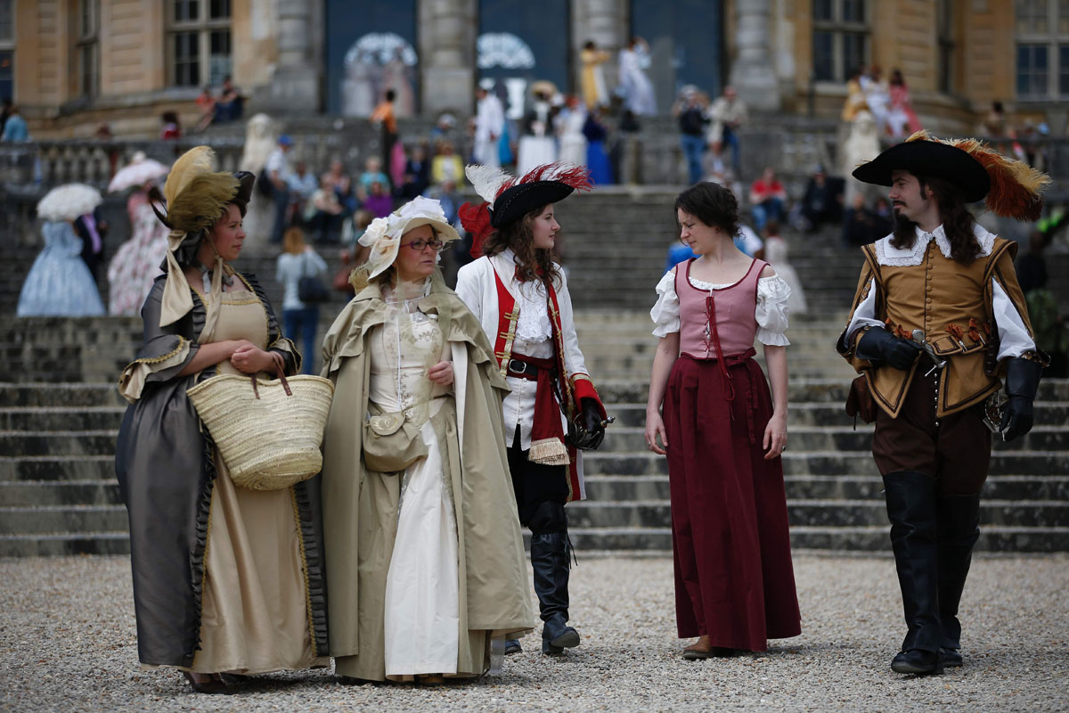
WHAT IS CULTURE?
The common values, habits, conventions, beliefs, and behaviors of a group of people are referred to as their culture. It includes language, religion, cuisine, social habits, music, and arts.
French cuisine, art (like the Louvre), literature (like Victor Hugo), and
cultural traditions all contribute
to the country's strong sense
of identity and influence
daily life and
patriotism.
Notes:
Culture encompasses the shared values, traditions, beliefs, and behaviors of a group of people. In France, this includes everything from cuisine and art to social customs and historical traditions.

Slide 3

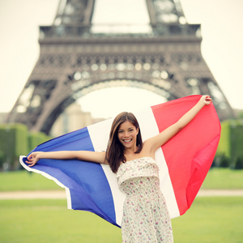
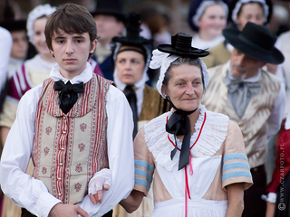
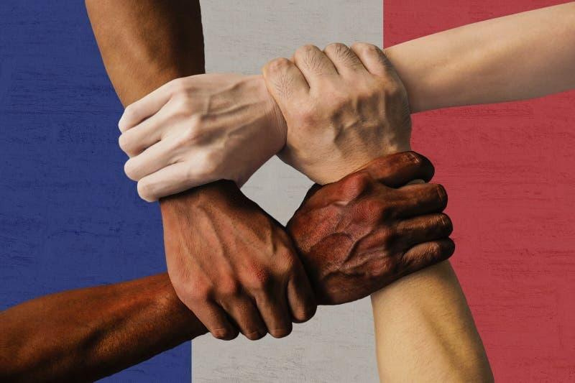
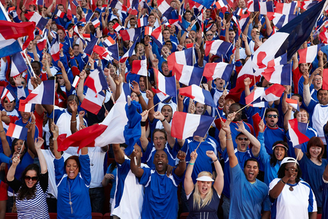
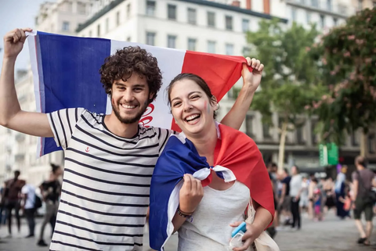
CULTURAL DIVERSITY IN REGIONS
The numerous regions of France display notable regional variations in terms of culture, cuisine, and dialects.
Southern France's Provence region is well-known for its Mediterranean food, lavender fields, and customary celebrations like the Avignon Theater Festival.
Notes:
France's regions exhibit distinct cultural variations. For instance, Provence is known for its Mediterranean cuisine, lavender fields, and unique festivals like the Avignon Theater Festival, showcasing regional diversity within the national culture.

Slide 4
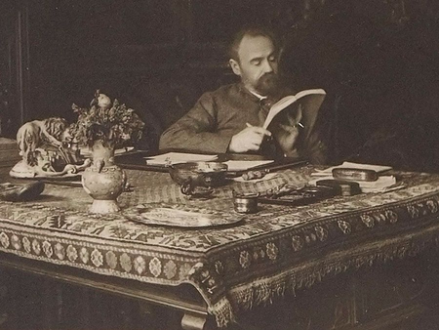
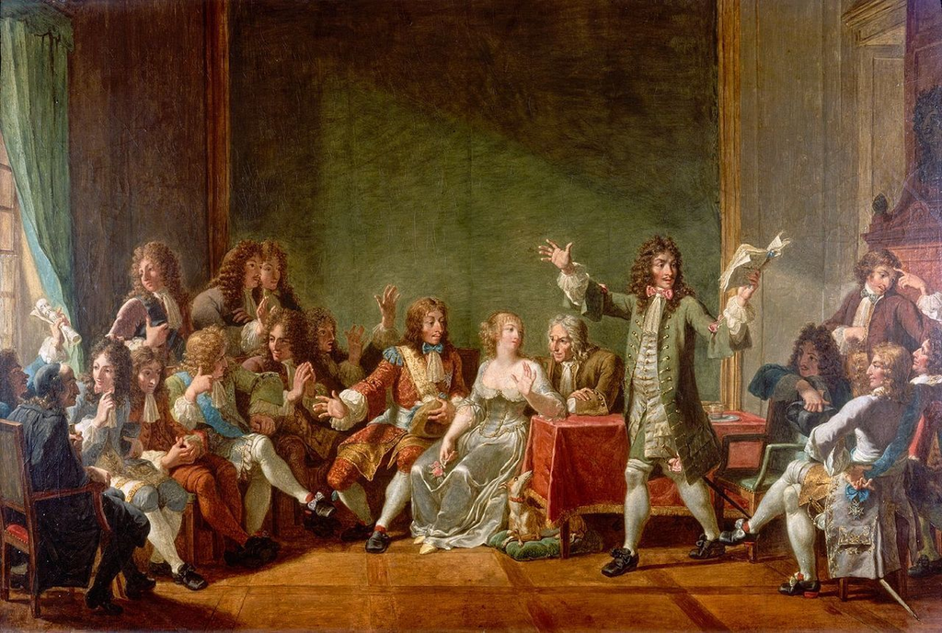

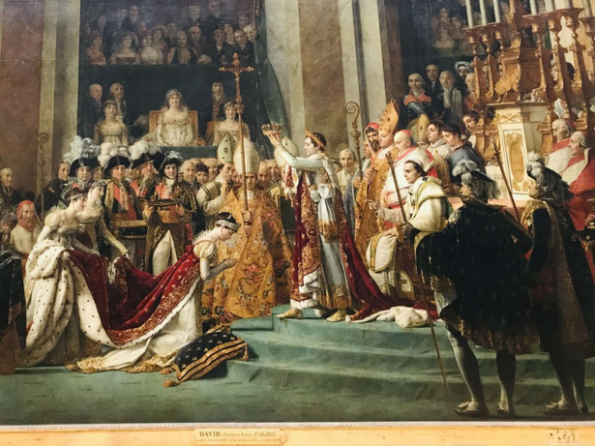
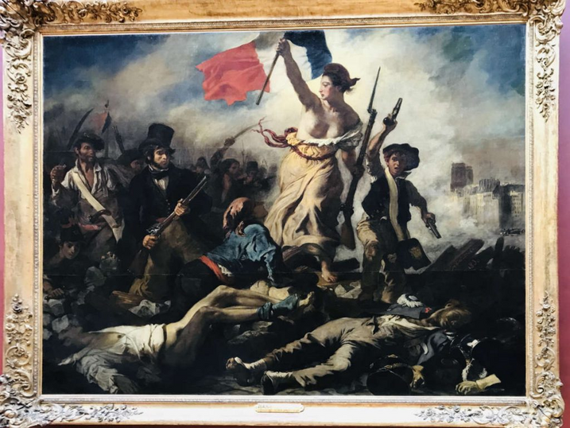
INFLUENCE OF ART AND LITERATURE
French literature and art, which represent intellectual curiosity and cultural sophistication, have had a significant influence on the world stage.
French authors like Victor Hugo and painters like Claude Monet have left a lasting legacy of inspiration and influence on global cultural movements.
Notes:
French literature and art, exemplified by figures like Victor Hugo and Claude Monet, have had a profound global impact, shaping intellectual discourse and artistic movements worldwide.

Slide 5

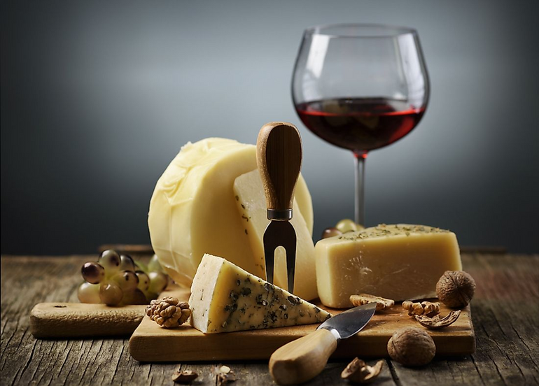
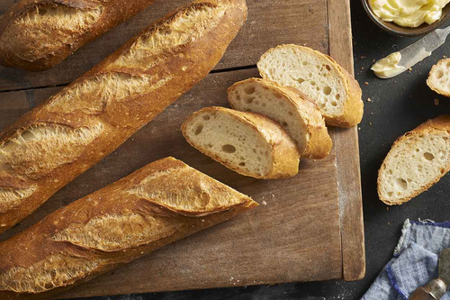

GASTRONOMIC EXCELLENCE
French cooking is renowned around the world for its variety of tastes and cooking methods.
The Michelin Guide was first published in France, showcasing the elite dining establishments and chefs that are
well-known for their skill in the kitchen.
Notes:
French cuisine is celebrated globally for its diversity and sophistication. The Michelin Guide, originating in France, underscores the country's culinary prestige and innovation.

Slide 6
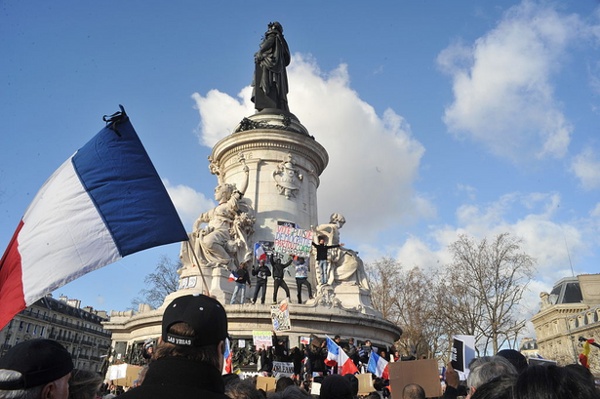

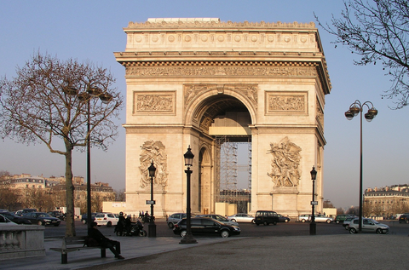
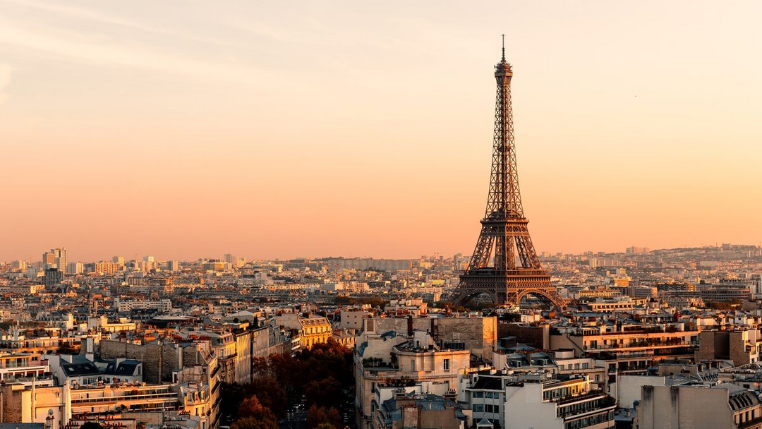
CULTURAL HERITAGE AND ARCHITECTURE
France boasts a rich cultural legacy, as seen by its magnificent architecture and historical sites.
A UNESCO World Heritage site, the Palace of Versailles represents French opulence and the historical significance of the monarchy.
Notes:
France's architectural marvels, like the Palace of Versailles, are UNESCO World Heritage sites, symbolizing both historical opulence and the country's cultural legacy.

Slide 7
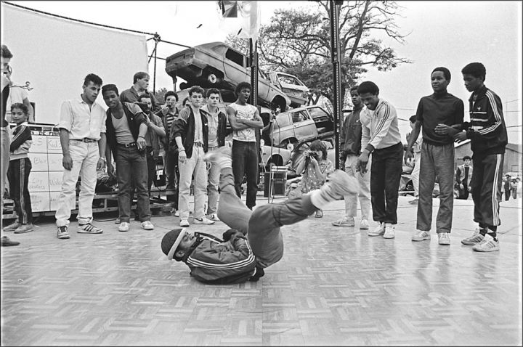
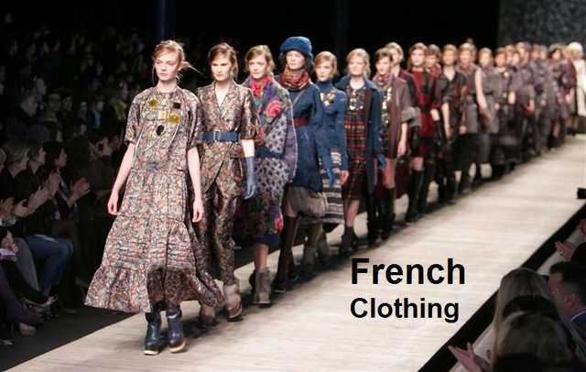
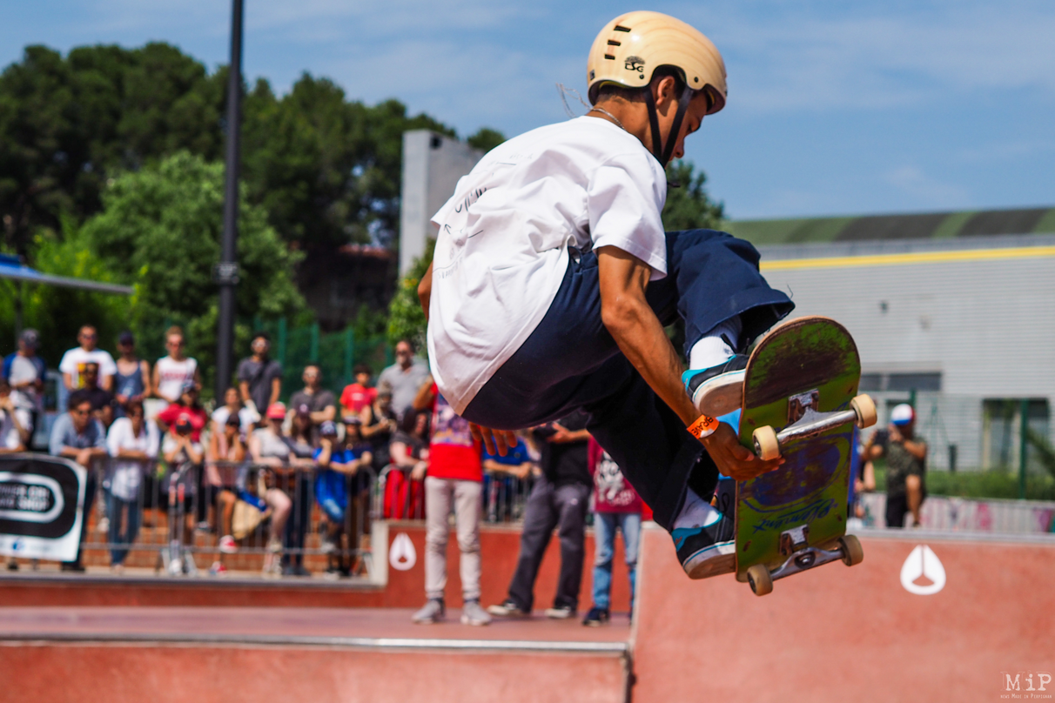
WHAT IS SUBCULTURE?
A subculture is a subset of a larger culture that sets itself apart from it through unique activities, beliefs, and values. include youth subcultures, ethnic subcultures,
and occupational subcultures.
Urban youth subcultures in France, including skateboarding and hip-hop, exhibit distinct tastes in music, clothes, and social mores. These organizations, which provide alternate identities and communities inside society, frequently emerge in reaction to popular culture.
Notes:
Subcultures in France, such as urban youth groups or ethnic communities, carve out distinct identities through unique activities, beliefs, and styles that diverge from mainstream culture.

Slide 8

SOCIAL AND CULTURAL CONCEPTS
Norms
Accepted standards of behavior in a society. Norms guide everyday interactions and social expectations.
Norms
Values
Symbols
Language
Rituals
It's usual to give someone a kiss on both cheeks, or "la bise," when you greet them in France. The quantity of kisses used in this greeting varies slightly between regions and is a crucial component of social graces.
Notes:
Norms are societal expectations that guide behavior. In France, practices like "la bise" (cheek kissing) illustrate cultural norms that vary regionally but signify social etiquette.

Slide 9

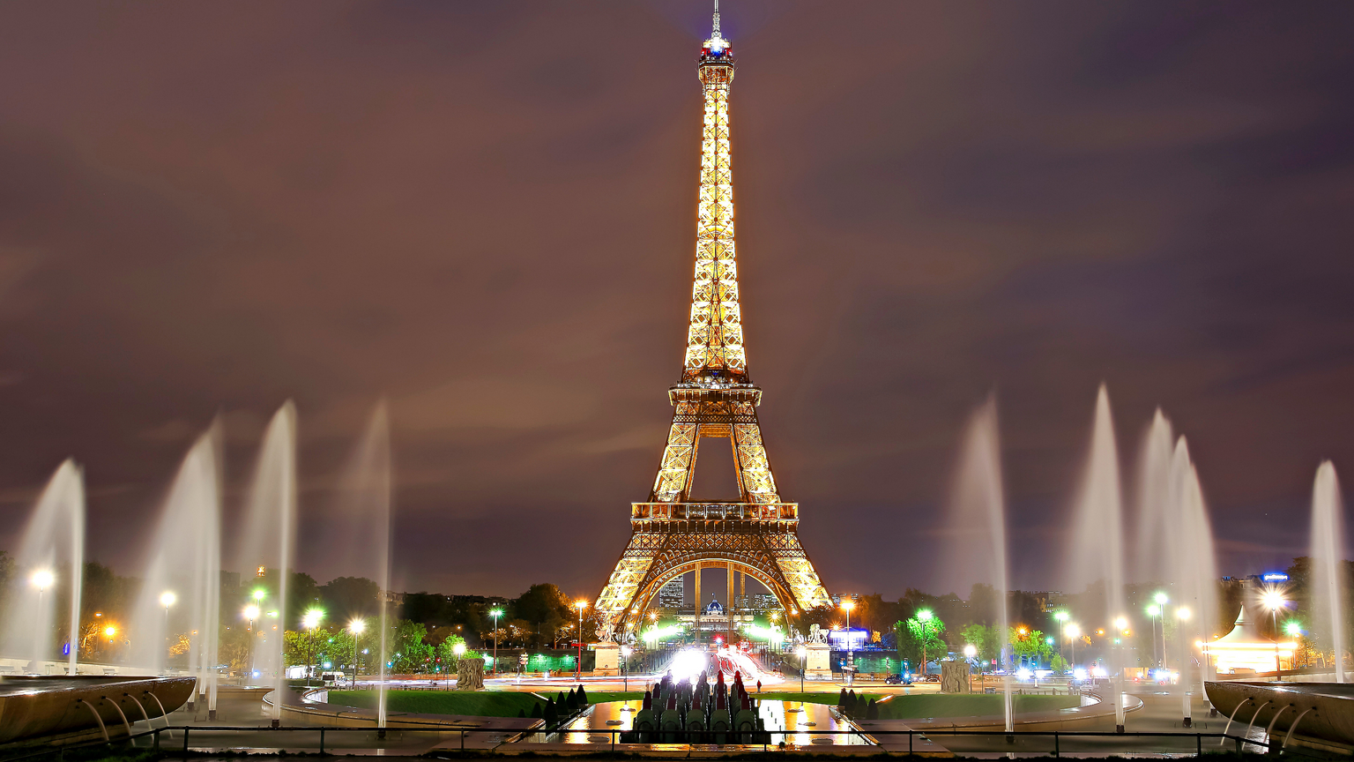
Values
Symbols
Deep convictions regarding what is good, right, and desirable. Values define a society's moral foundation and priorities.
Objects or gestures that represent a particular meaning. Symbols carry significant cultural and historical meanings.
The French national motto "liberté, égalité, fraternité" (liberty, equality, fraternity) represents the nation's essential principles. This slogan emphasizes the value of individual liberty, social equality, and community solidarity, all of which have been essential to French society since the French Revolution.
The Eiffel Tower is one of France's most famous symbols. It embodies French architectural inventiveness, the city's romantic attractiveness, and national pride. Other symbols include the French flag (blue, white, and red) and the rooster, which represents French identity and perseverance.
Notes:
Values like "liberté, égalité, fraternité" (liberty, equality, fraternity) embody France's moral principles and societal ideals, influencing everything from law to social policy.

Slide 10
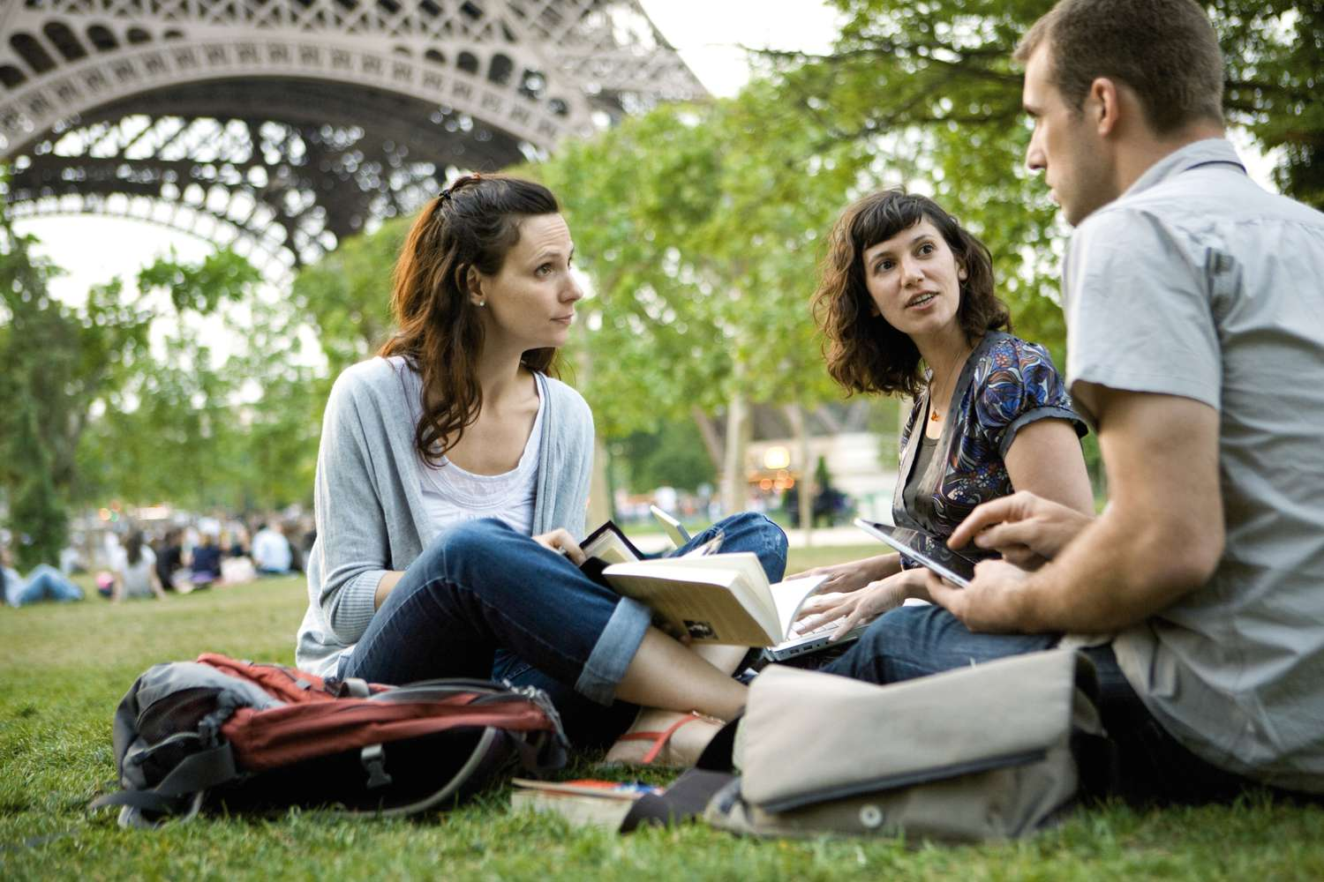
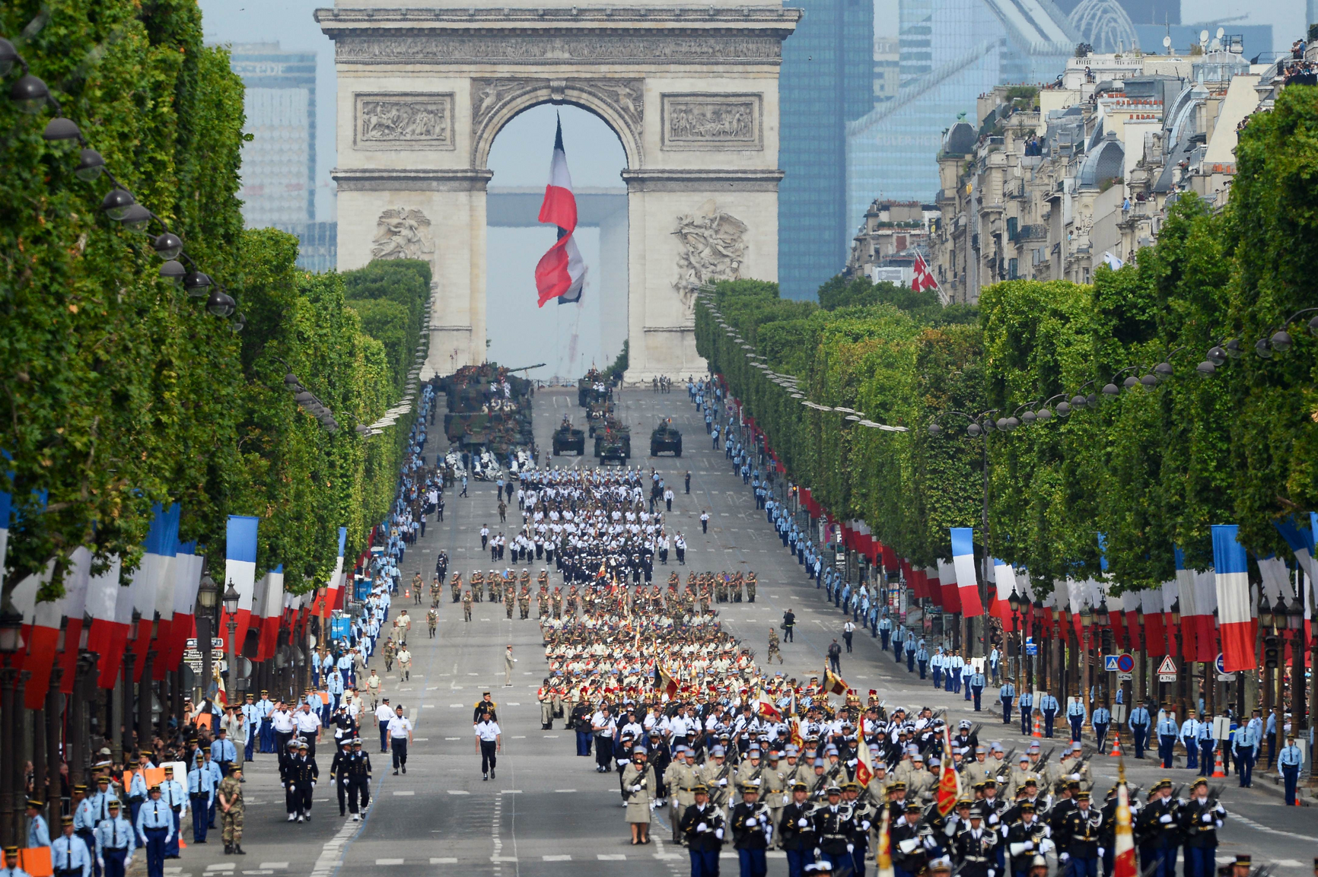
Language
A system of communication used by a particular community. Language is a key cultural component that conveys traditions, beliefs, and collective identity.
Rituals
Formalized actions performed in specific circumstances. Rituals reinforce cultural values and community bonds.
French is the official language of France and is important to its cultural identity. The French are very proud of their language, which is reflected in efforts to maintain its purity through institutions such as the Académie Française. The richness of French literature, cinema, and philosophy demonstrates the language's cultural relevance.
Bastille Day, celebrated on July 14th, celebrates the storming of the Bastille prison in 1789, a watershed moment in the French Revolution. The day is celebrated across the country, with military parades on the Champs-Élysées, fireworks, celebrations, and community dinners, all of which serve to reinforce national solidarity and pride.
Notes:
Symbols such as the Eiffel Tower and the French flag carry deep cultural meanings, representing national identity, pride, and historical significance.

Slide 11
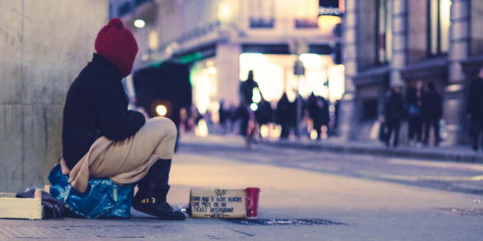
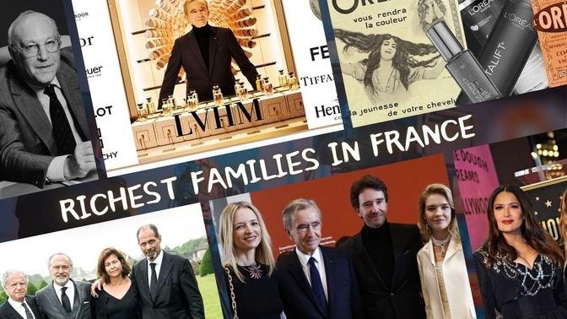
SOCIAL CLASS
Social class is a hierarchical structure that influences social mobility and resource access. It is based on wealth, occupation, and prestige.
The working class, bourgeoisie (middle class), and aristocracy have historically made up French social class. These social classes maintain social
stratification and inequality
by influencing education,
culture, and lifestyle
choices.
Notes:
France's social structure historically includes distinct classes like the working class, bourgeoisie (middle class), and aristocracy, shaping societal roles and opportunities.

Slide 12
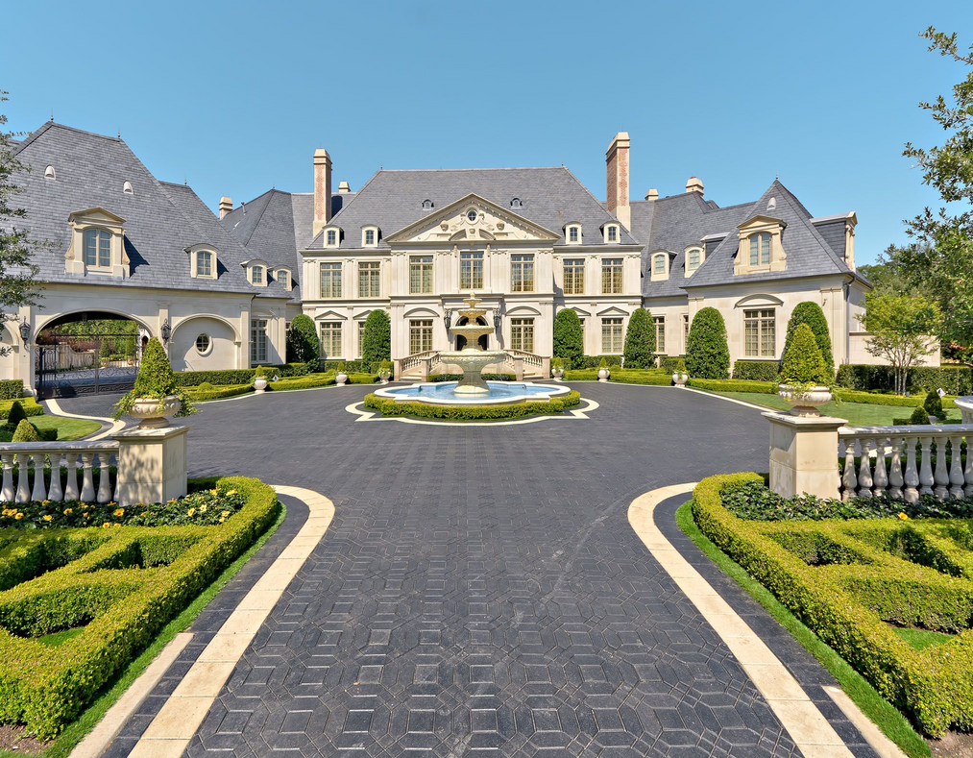
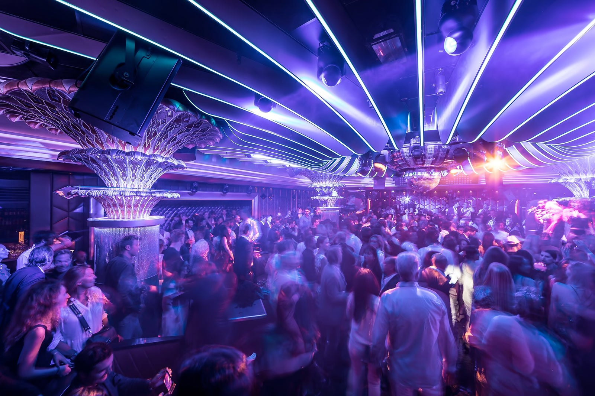
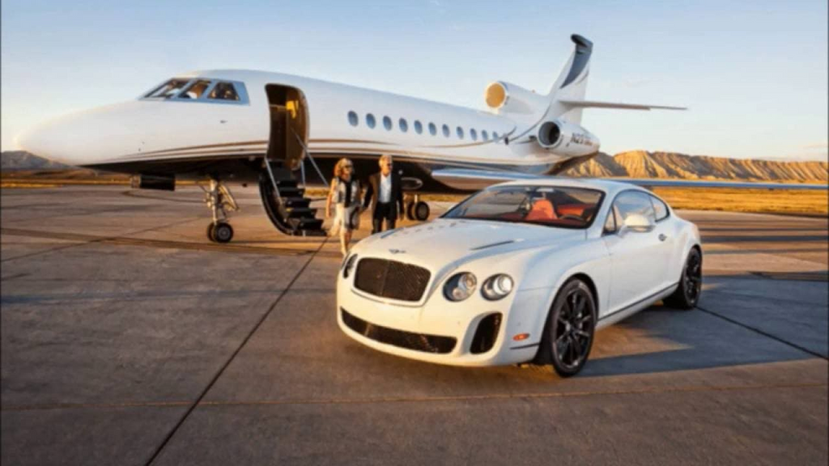
HIGH CLASS
The high class, or elite, comprises wealthy individuals and families with high social prestige and influential positions.
The upper class in France consists of political figures, corporate tycoons, and affluent families who live in affluent districts and have access to private schools and cultural activities.
Notes:
The high class in France comprises influential figures in politics, business, and culture, reflecting wealth, status, and access to exclusive resources.

Slide 13
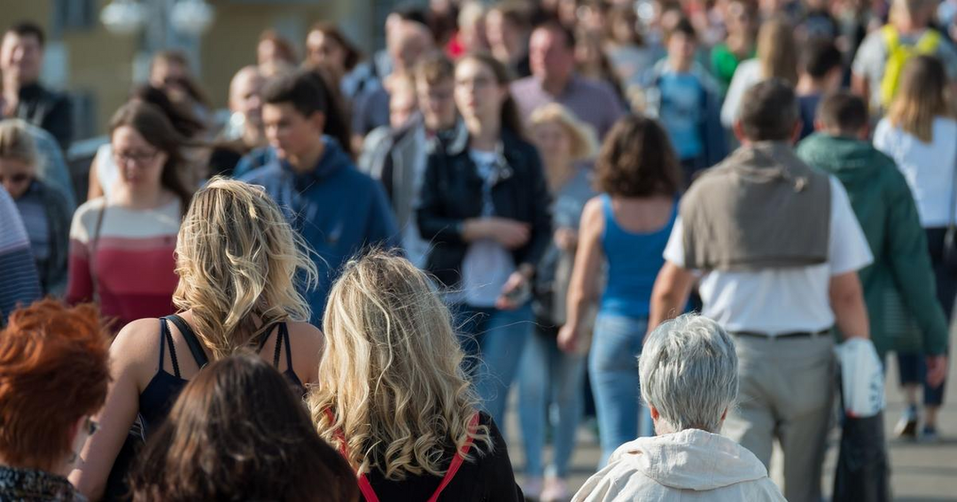
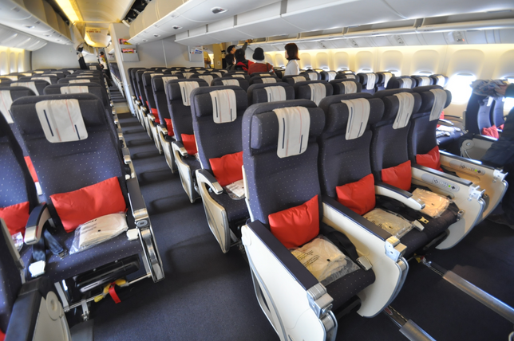


MIDDLE CLASS
People and families in the middle class typically have modest earnings and work in professional, corporate, or skilled labor roles.
The French middle class, which is made up of educators, medical professionals, engineers, and small company owners, is essential to the country's economy and enjoys access to quality healthcare and education.
Notes:
The middle class includes professionals and skilled workers who contribute significantly to the economy while enjoying access to education and healthcare.

Slide 14
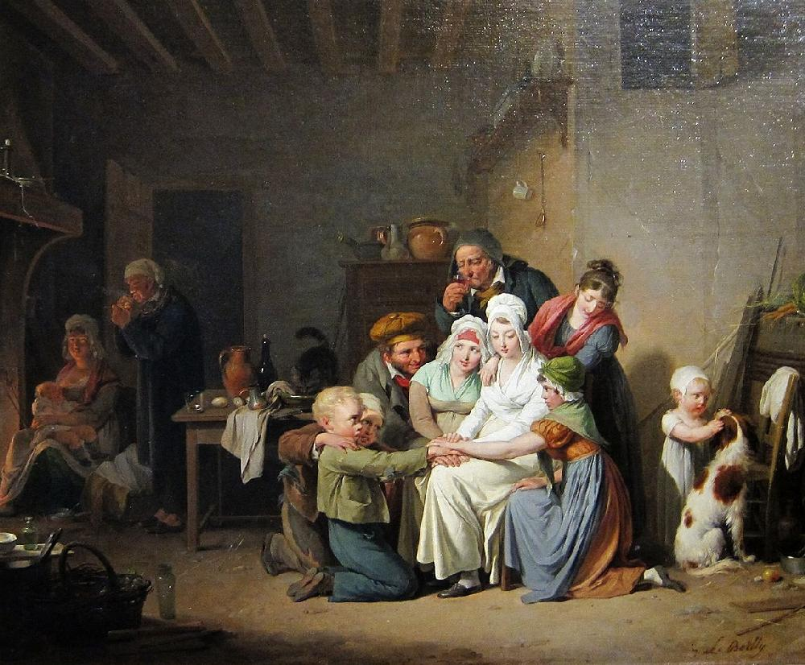
LOWER CLASS
The lower class is made up of people and families with low incomes who frequently work at low-paying occupations or are unemployed and have restricted access to opportunities and resources.
In France, people in manual labor, service industries, and employment with insecurity are frequently considered lower class since they have restricted social mobility and have financial difficulties.
Notes:
The lower class consists of individuals with limited economic means and opportunities, often engaged in manual labor or service industries.s.

Slide 15
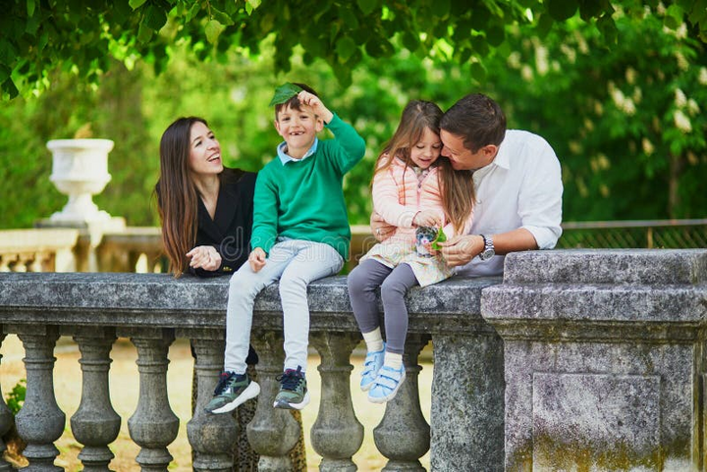
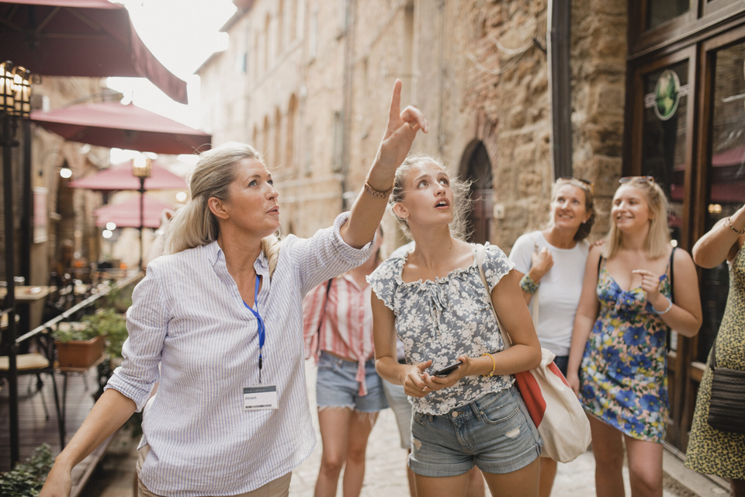
RELATIONSHIPS WITHIN SOCIAL GROUPS
Family
Peers
France places a high value on family, welcoming both conventional and modern family forms. Meals strengthen family ties and unity, especially on Sundays.
During adolescence in France, peers greatly influence behavior and identity through shared interests like sports and music, fostering social networks and belonging beyond the family.
Notes:
Family plays a central role in French society, fostering unity through shared meals and traditions. Peers also influence identity formation, particularly during adolescence.

Slide 16
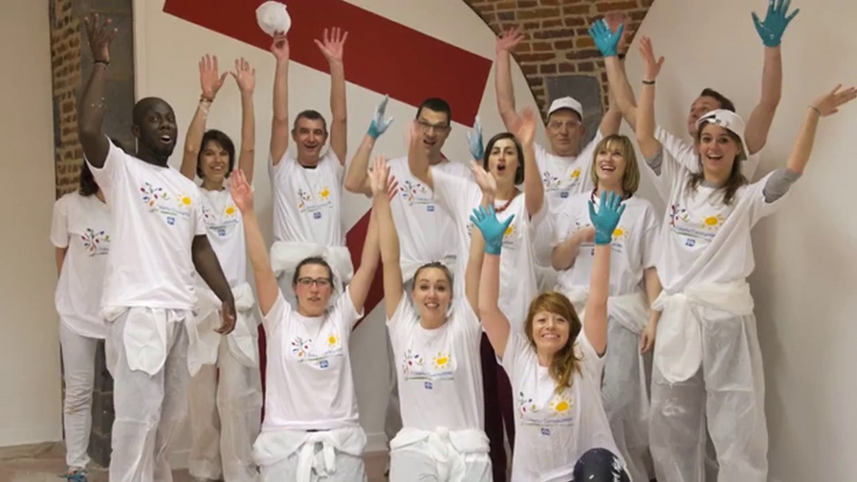

Communities
Organizations
Local communities in France foster identity through vibrant markets, events, and associations. Rural areas emphasize tradition and strong ties, while cities offer diverse interactions.
Formal organizations like schools, workplaces, and nonprofits play a crucial role in French social life. They serve as hubs for both learning and forging enduring social connections through team activities and gatherings.
Notes:
Local communities and formal organizations like schools and nonprofits provide platforms for social interaction and cultural expression in France.

Slide 17

INTERACTIONS BETWEEN SOCIAL GROUPS
INTERGROUP RELATIONS
France's history is marked by interactions between various ethnic and religious groups, such as the French majority, North African immigrants, and indigenous communities like the Bretons. These groups often experience both cooperation, as seen in cultural festivals and shared civic engagement, and conflict, exemplified by tensions over immigration policies and integration challenges.
Notes:
France's diverse ethnic and religious communities interact through shared cultural events and civic engagement, though tensions over integration policies can also arise.

Slide 18
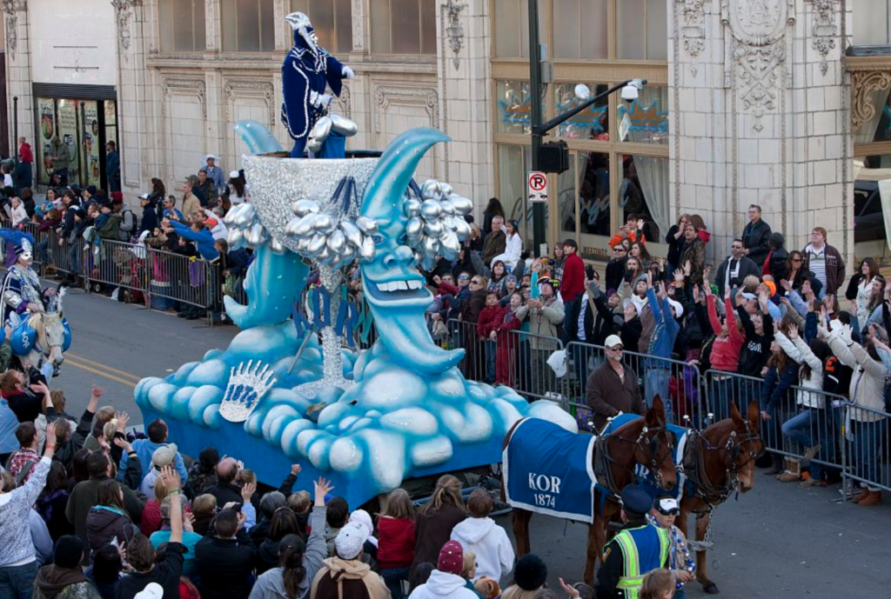
CULTURAL EXCHANGE
French culture is well known throughout the world for its contributions to philosophy, food, and art. International film festivals, such as the Cannes Film Festival, facilitate cultural exchange by providing a platform for filmmakers from other backgrounds to present their work, thereby promoting global discourse and awareness of cultural variety.
Notes:
Cultural exchange, facilitated by events like the Cannes Film Festival, promotes global understanding and appreciation of French contributions to art, philosophy, and cuisine.

Slide 19
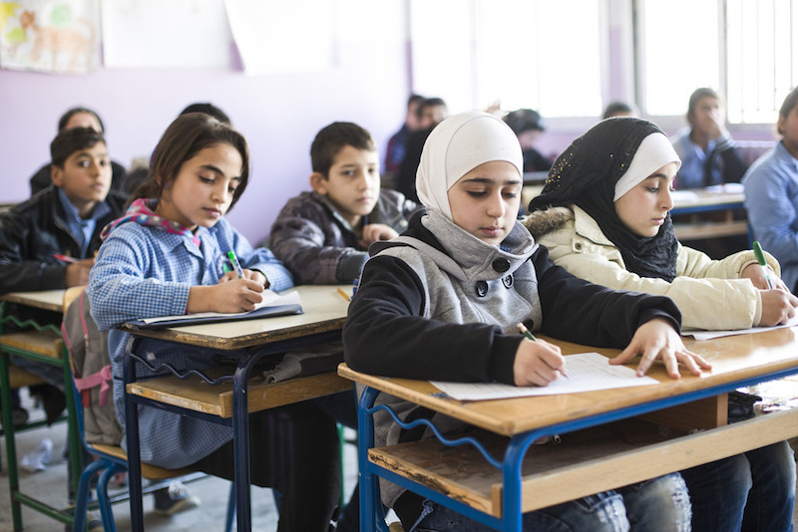
SOCIAL INTEGRATION
The goal of social integration in France is to unite disparate groups into a single, cohesive community. In an attempt to forge a shared national identity while honoring individual cultural variety, measures supporting secularism in public institutions and French language competency are among those being implemented.
Notes:
Social integration efforts in France aim to forge a cohesive national identity while respecting cultural diversity, emphasizing secularism and language competency.

Slide 20
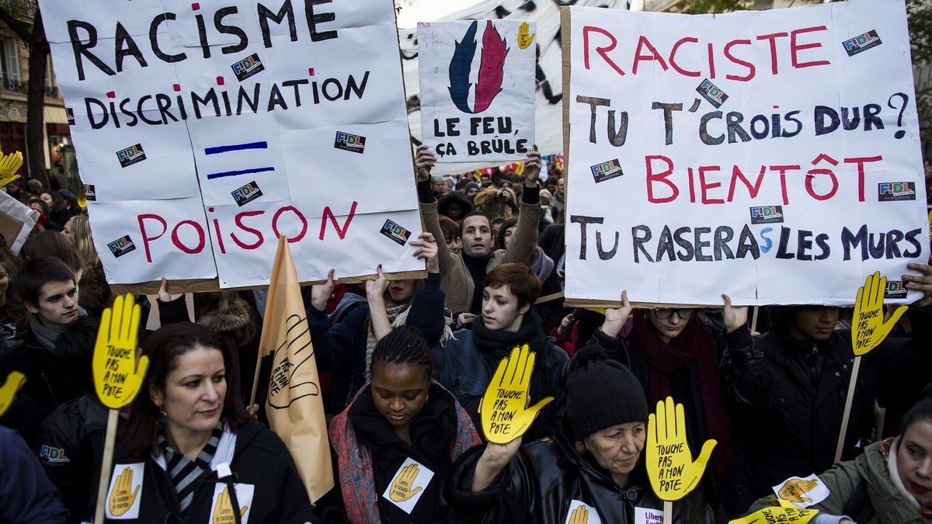
DISCRIMINATION
Discrimination in France persists despite efforts to be more inclusive on the basis of socioeconomic background, religion, and ethnicity. Discrimination is evident in public discourse, housing access, and employment practices, underscoring the need for continual legislative intervention and conversation as well as community conflicts.
Notes:
Despite efforts to promote inclusivity, discrimination based on socioeconomic status, religion, and ethnicity persists in France, highlighting ongoing challenges in social equity.

Slide 21
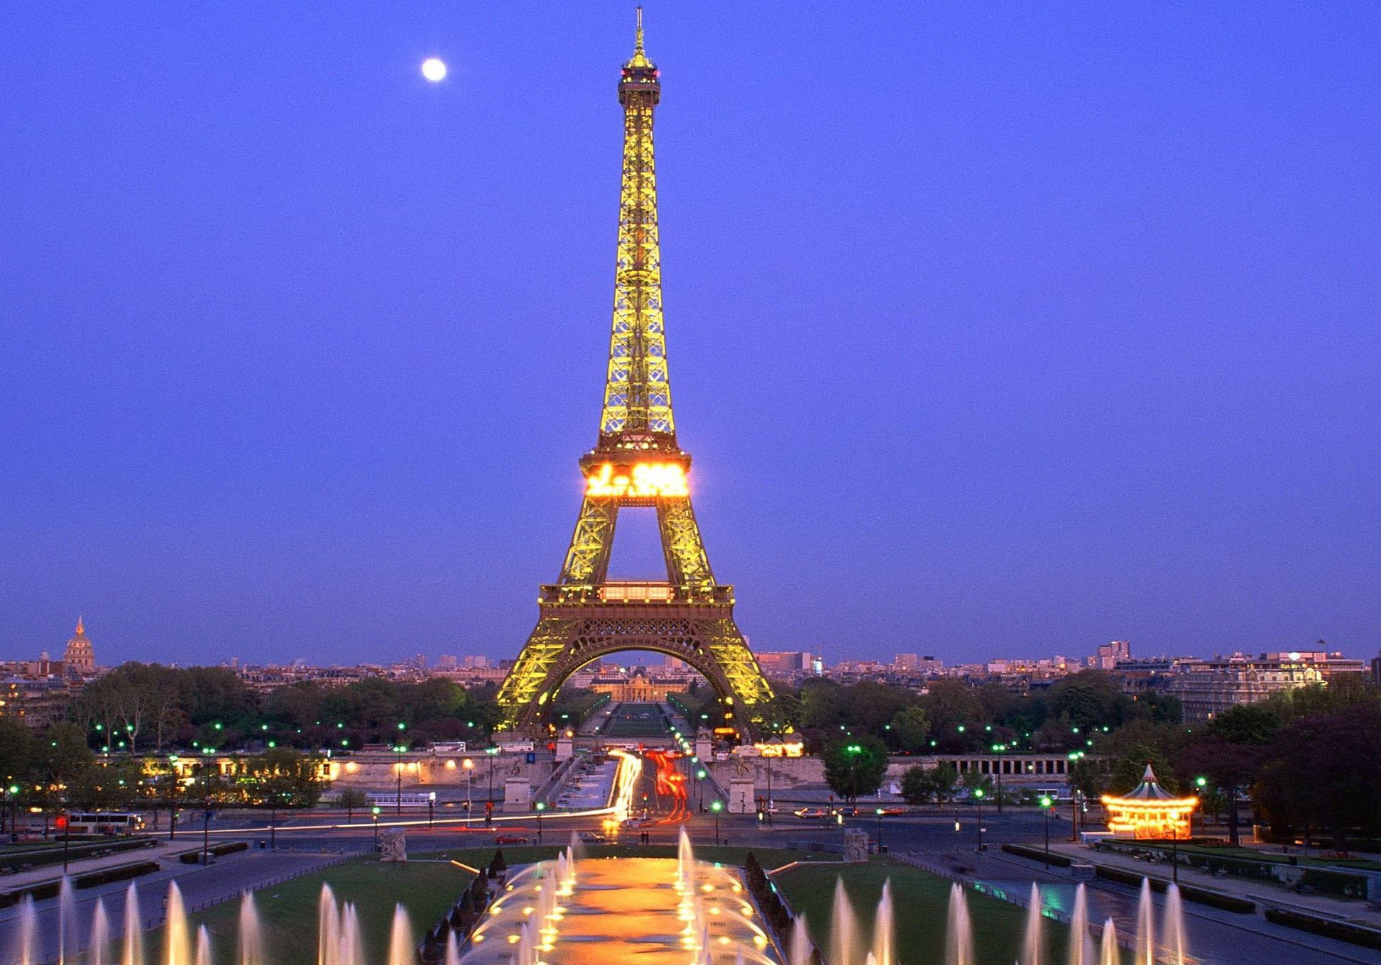
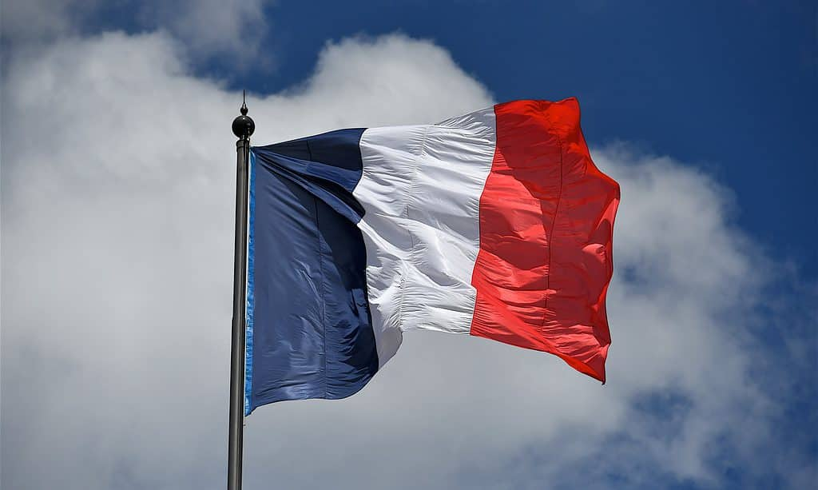
CONCLUSION
Centuries of history and variety have woven a complex cultural tapestry that presents a France steeped in tradition but rapidly changing. France is a prime example of both unity and diversity, from its well-known gastronomy and artistic legacy to its intricate social structures and persistent problems with discrimination. Through comprehending and valuing these complex components, we can promote increased cultural sensitivity and aid in the development of a more inclusive society in France and around the world.
Notes:
France's cultural richness and complexity offer valuable insights into unity amid diversity. By understanding and respecting these dynamics, we can foster greater cultural sensitivity and inclusivity globally.

Slide 22
REFERENCE
https://www.france.fr/en/article/discovering-french-culture/#french-cuisine-a-gastronomic-ballet-2
https://www.berlitz.com/blog/french-culture-traditions-customs
https://artincontext.org/french-art/
https://culturalatlas.sbs.com.au/french-culture/french-culture-core-concepts
https://snippetsofparis.com/french-culture-facts/
https://www.justlearn.com/blog/french-culture
https://www.thecanadianencyclopedia.ca/en/article/aboriginal-french-relations

Slide 23


THANK YOU
by YASIRU PRABODHA
CL/OTHMFL3/11/90

